Slide 1
Heredity Notes
Variation
Sexual reproduction (meiosis & fertilization)
Mutation
Reading & Activities
BIOLOGY WA UNITS 3&4
Chapter 4 Variation and Mutation pg. 91-110
Questions
Set 4.4 pg. 95 Q 1-5
Set 4.5 pg. 97 Q 1-5
Set 4.6a pg. 100 Q 1-4
Set 4.6b pg. 107 Q 1-8
Set 4.7 pg. 110 Q 1-5
BIOZONE
Activity Number: 166, 170, 172, 175, 176, 177, 178,

Slide 2
Variations in genotype of offspring arise as a result of the processes of meiosis, including crossing over & random assortment of chromosomes, and fertilisation, as well as a result of mutations
Explain how sexual reproduction and mutations result in variation in genotype of offspring
Syllabus:
Heredity
Essential
Question:
Sources of variation
Topic Question 1:
What are the main mechanisms for genotypic and phenotypic variation?
Change in genotype
Environmental factors
Epigenetics
Chemicals that can switch genes on or off (only changes phenotypes, not genotypes)
Internal (e.g. presence or absence of hormones) and external environmental factors (e.g. temperature and light intensity)
Change in phenotype
Random fertilisation/mating
Crossing Over
Topic Question 2:
Describe how sexual reproduction increases to genetic variation
Sexual reproduction
Meiosis
Random Assortment

Slide 3
Topic Question 3: Genetic Variation is a prerequisite for evolution. Mutation is one source of genetic variation and meiosis is another. Name and describe the two ways in which meiosis produces genetic variation 10 marks

Slide 4
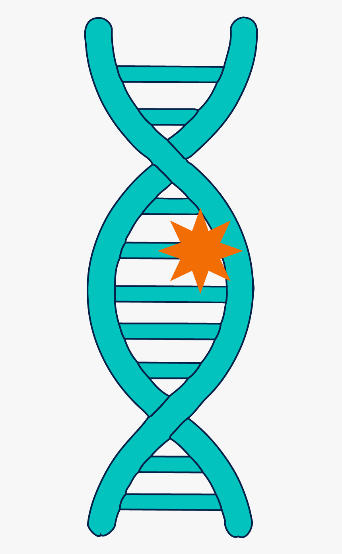
Topic Question 5: State the difference between a somatic and a germline mutation
Topic Question 4:
Mutation is said to be the ultimate source of variation. Explain what is meant by this statement

Slide 5
Topic Question 6: Discuss the consequences of a mutation occurring in a germline cell and in a somatic cell
Consequences of Germline mutation | Consequences of somatic mutation
Cell Division
Topic Question 7: What are the causes of mutations
Replication errors
Causes of mutation
Mutagens

Slide 6
Topic Question 8: Define the term mutagen
Mutagen Type | Physical | Chemical | Biological
Examples the mutagen
Effects of mutagen on DNA
Specific example of the mutagen causing a mutation
Topic Question 9:
Explain, including examples, how physical mutagens in the environment can cause mutations

Slide 7
Topic Question 10:
What is a gene mutation?
Topic Question 11:
Describe the three types of point mutations

Slide 8
Type of Substitution mutation | Silent or Synonymous | Nonsense | Missense
Explanation
Effect
Deleterious or beneficial
Topic Question 12:
Describe the possible effects of a substitution mutation

Slide 9
Topic Question 13:
Describe the possible effects of a deletion or insertion mutation
Topic Question 14:
Describe the possible effects of a deletion or insertion if the mutated DNA sequence is transcribed in mRNA

Slide 10
Topic Question 15:
What are Chromosome mutations?
Topic Question 16:
Describe the terms monoploidy, aneuploidy and polyploidy

Slide 11
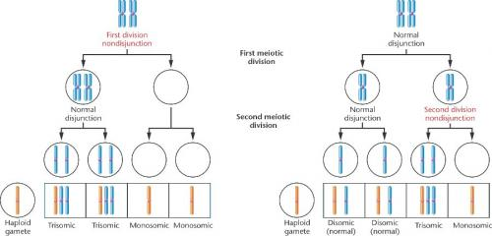
Topic Question 17:
Describe non-disjunction and how it can lead to aneuploidy or polyploidy

Slide 12
Topic Question 18:
Describe how Genetic variation can be caused by changes to chromosome structure

Slide 13
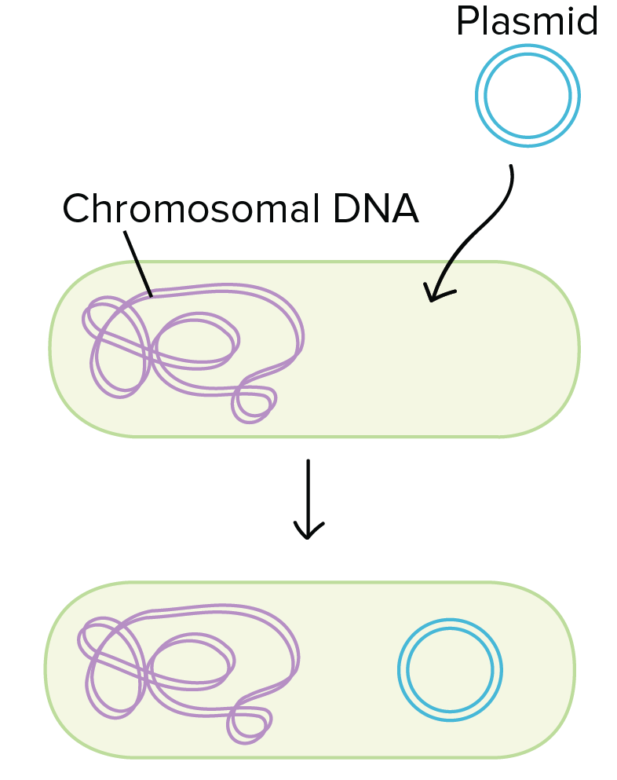
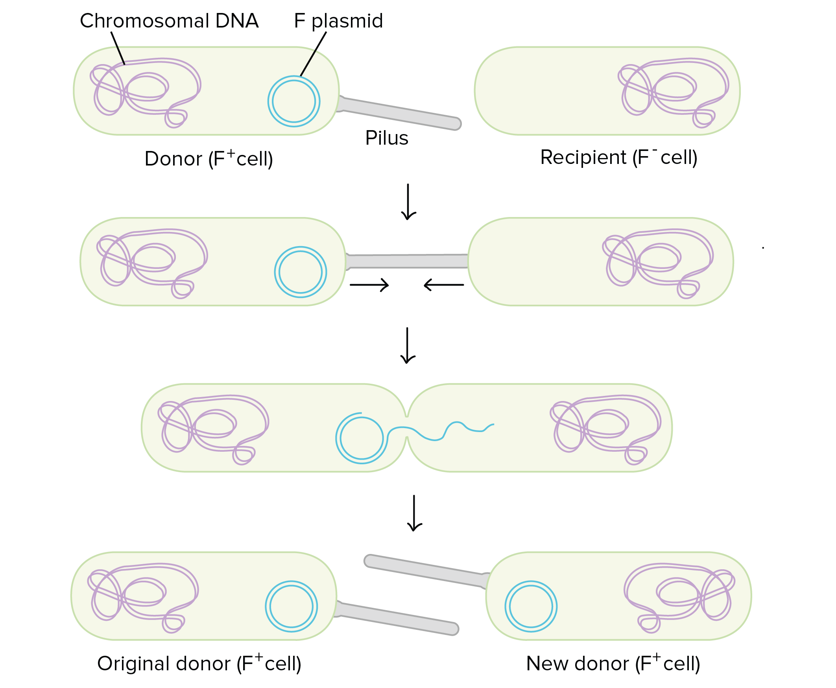
Topic Question 19:
Describe how genetic variation can occur in asexually reproducing prokaryotes

Slide 14
Sum it up!
Draw a mind map summarizing how sexual reproduction & mutations increase genetic variation

